Slide 1

Using Data Science to Analyze the Neighborhoods of Seattle
Sophia Yu

Slide 2

Introduction
Since COVID-19 lockdown in the United States, trend of remote working and moving away from big, expensive cities
Interest in moving to Seattle, Washington
What is the safest neighborhood in Seattle?
What are the top common venues in the neighborhood?

Slide 3
Methodology
Gather datasets
Data cleaning
Exploratory data analysis of crime data
K-means clustering of crime data
Pick a cluster to explore
Explore venues in the cluster using Foursquare API
Pick the best neighborhood in the cluster

Slide 4
Data Sources
Seattle crime dataset: available for public download from Seattle PD website
Seattle districts & neighborhoods: web scrape Wikipedia page
Venue information: Foursquare API

Slide 5
Methodology
Gather datasets
Data cleaning
Exploratory data analysis of crime data
K-means clustering of crime data
Pick a cluster to explore
Explore venues in the cluster using Foursquare API
Pick the best neighborhood in the cluster

Slide 6

Data Cleaning
Limited crime dataset to only the past year (Aug 2019 to Aug 2020) = 76,931 records
Deleted anything with brackets in web-scraped neighborhood dataset
Used geocoder to gather latitude and longitude coordinates
Drop any rows with no coordinate info
Map coordinates and manually change any outside of Seattle area using Google Maps

Slide 7
Methodology
Gather datasets
Data cleaning
Exploratory data analysis of crime data
K-means clustering of crime data
Pick a cluster to explore
Explore venues in the cluster using Foursquare API
Pick the best neighborhood in the cluster

Slide 8
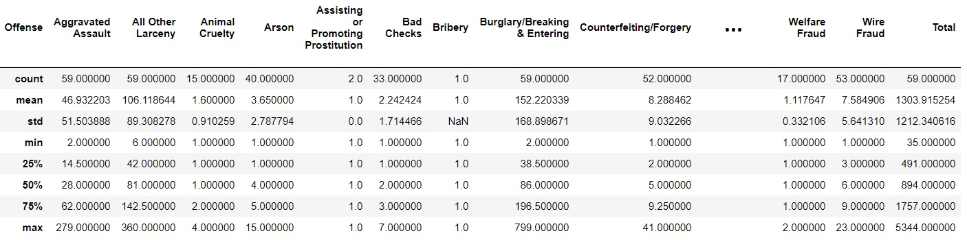
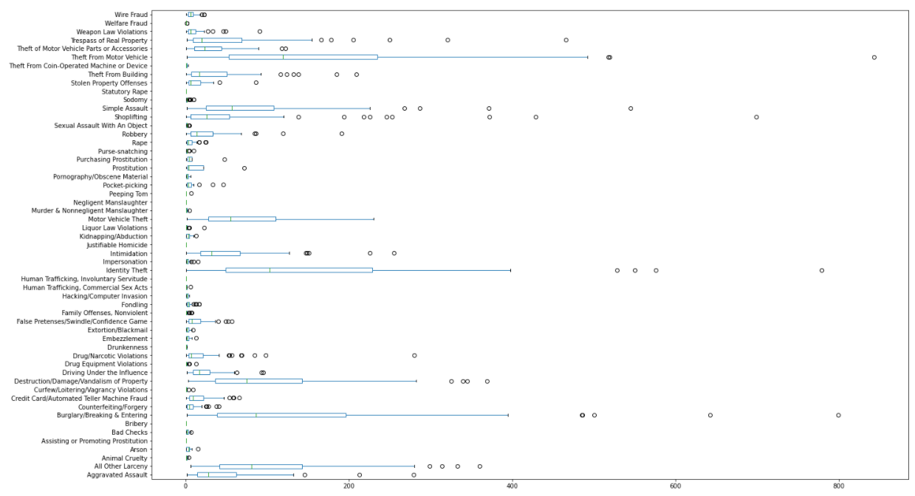
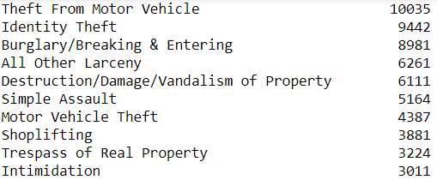
Exploratory data analysis of crime dataset
Descriptive stats of each offense
Top 10 Crimes in Seattle

Slide 9
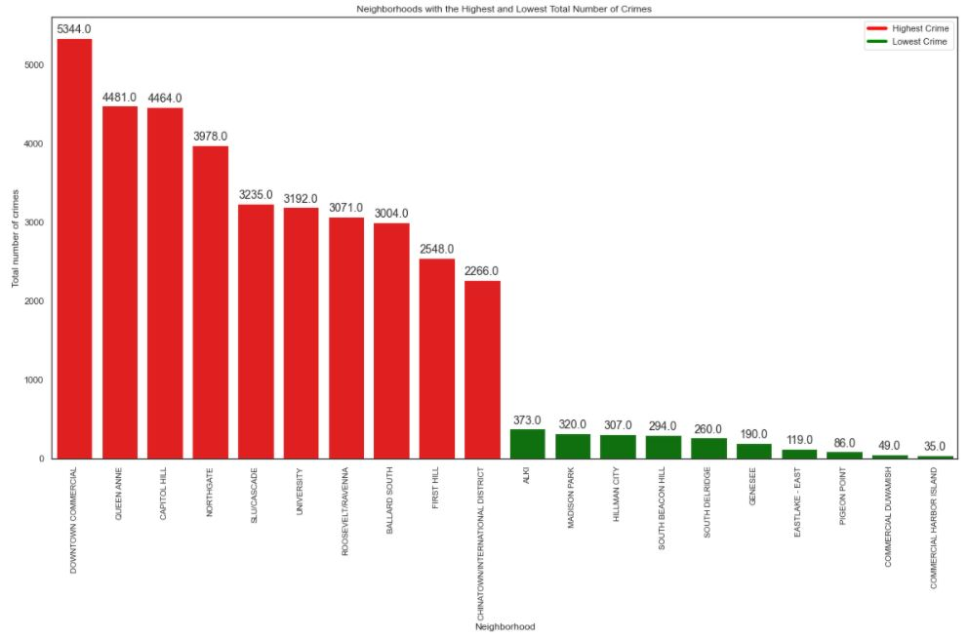
Seattle districts with highest and lowest crime

Slide 10
Methodology
Gather datasets
Data cleaning
Exploratory data analysis of crime data
K-means clustering of crime data
Pick a cluster to explore
Explore venues in the cluster using Foursquare API
Pick the best neighborhood in the cluster

Slide 11
K-means clustering of crime data
What is it and why use it? Unsupervised learning algorithm that will be used to group or classify large crime dataset to identify districts based on safety
To prepare dataset: one-hot encoding turns categorical variables into binary vectors
Chose to group into 5 clusters

Slide 12
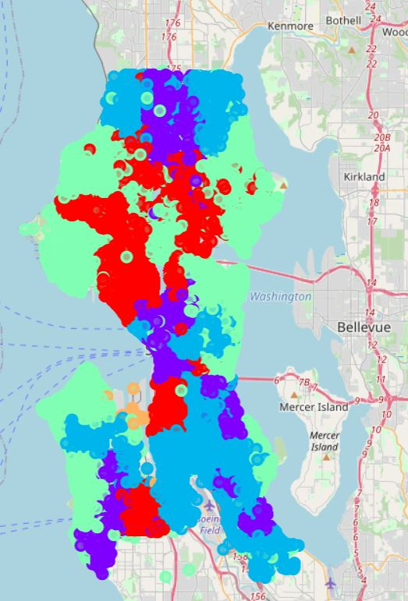
Result from k-means clustering
Cluster 0 = red
Cluster 1 = purple
Cluster 2 = blue
Cluster 3 = green
Cluster 4 = orange

Slide 13
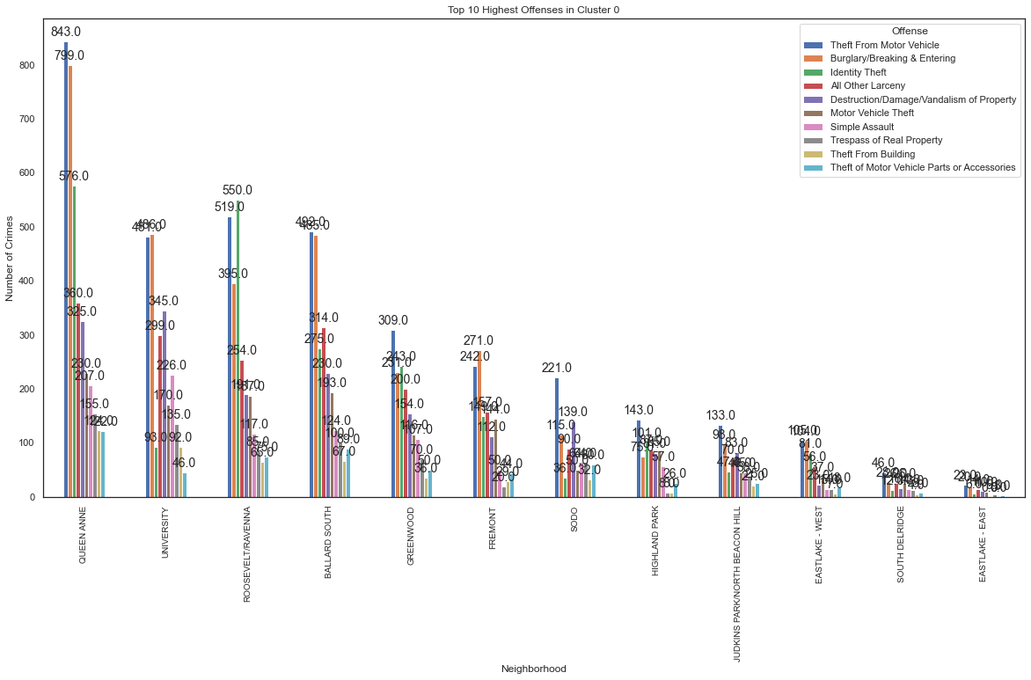
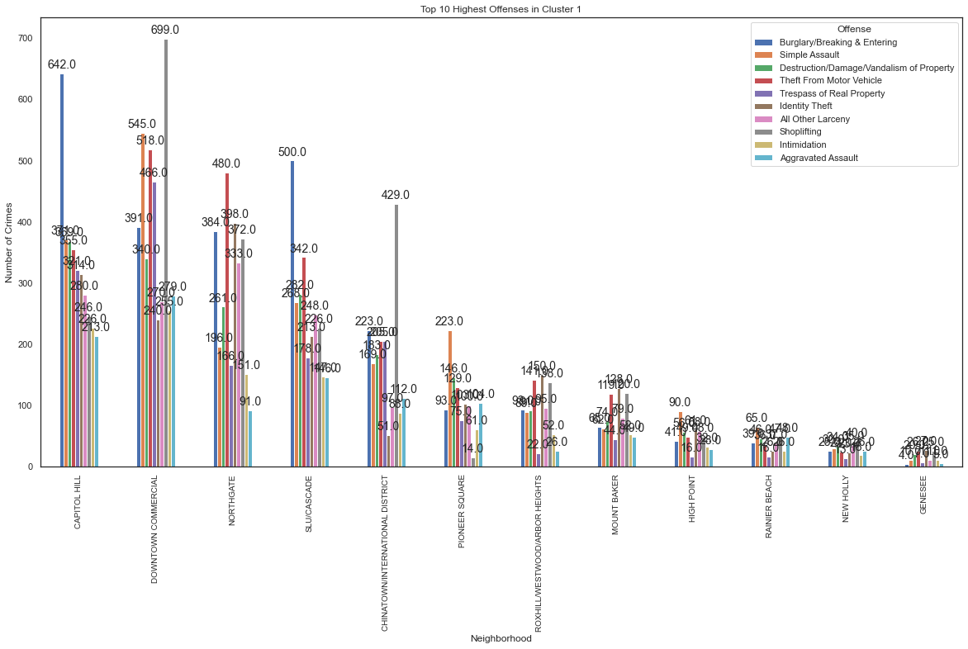
Cluster 0
Cluster 1
High crime districts: Queen Anne, University, Roosevelt/Ravenna, South Ballard
- Mostly motor vehicle theft & burglary
High crime districts: Capitol Hill, Downtown, Northgate, SLU/Cascade, Chinatown/International District
- Mostly burglary, shoplifting, simple assault, & motor vehicle theft

Slide 14
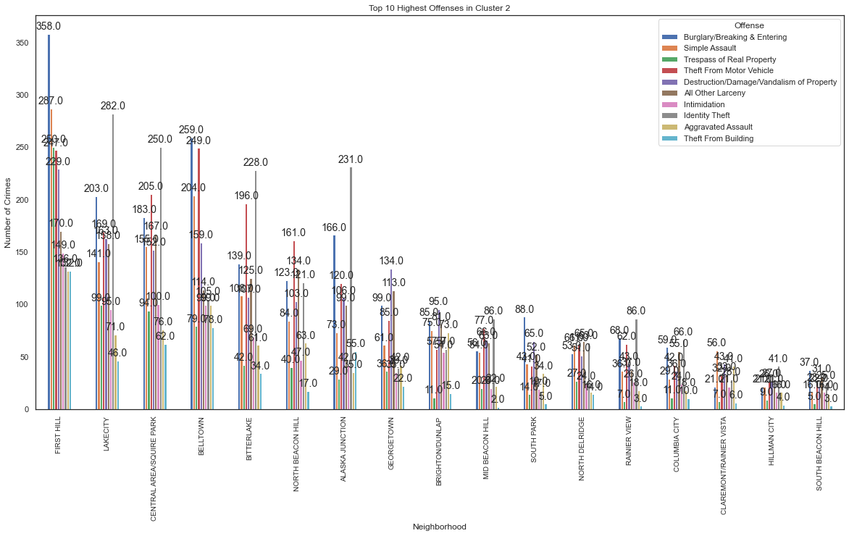
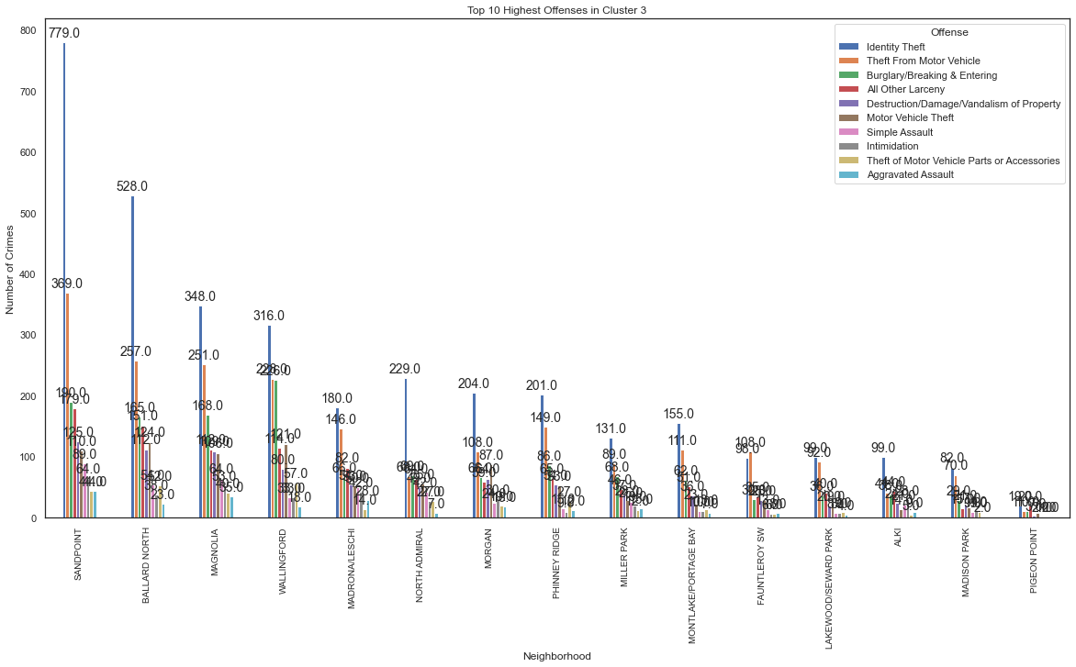
Cluster 2
Cluster 3
High crime districts: First Hill, Lakecity, Central Area/Square Park, Belltown, Bitterlake, Alaska Junction
- Mostly burglary, identity theft & motor vehicle theft
High crime districts: Sandpoint, North Ballard, Magnolia, Wallingford
- Mostly identity theft & motor vehicle theft

Slide 15
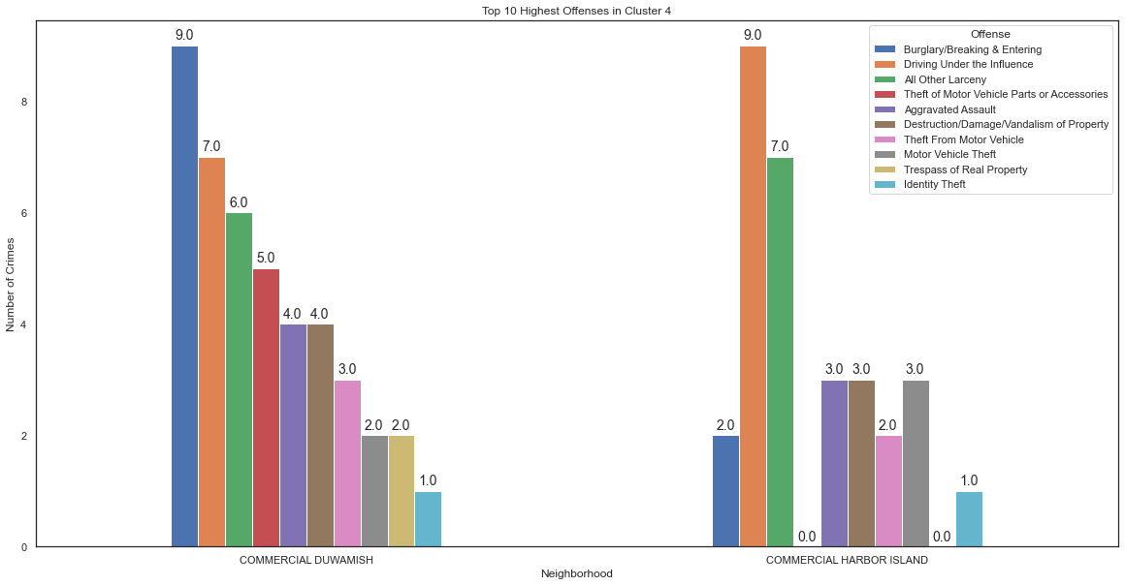
Cluster 4
Seems to only contain commercial areas where not a lot of crime happens

Slide 16
Now, we pick a cluster to explore
Cluster 3 is the only cluster that didn’t contain any districts in the top 10 highest crime district bar chart
So, chose cluster 3 to explore further

Slide 17
Methodology
Gather datasets
Data cleaning
Exploratory data analysis of crime data
K-means clustering of crime data
Pick a cluster to explore
Explore venues in the cluster using Foursquare API
Pick the best neighborhood in the cluster

Slide 18
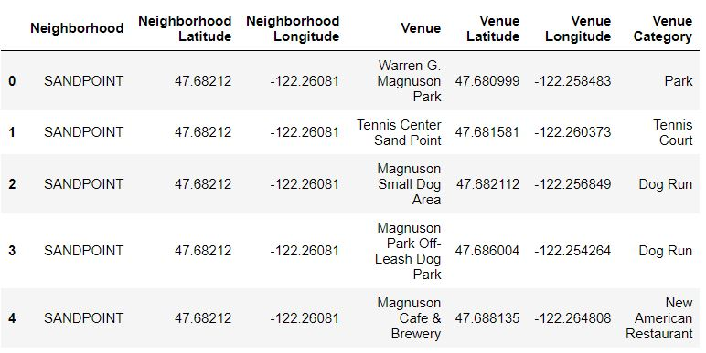
Get venue categories for Cluster 3
Combine neighborhood data with districts in Cluster 3
Call Foursquare API to get top 100 venues within a radius of ~1 mile for each neighborhood
Result = 1,519 venues

Slide 19
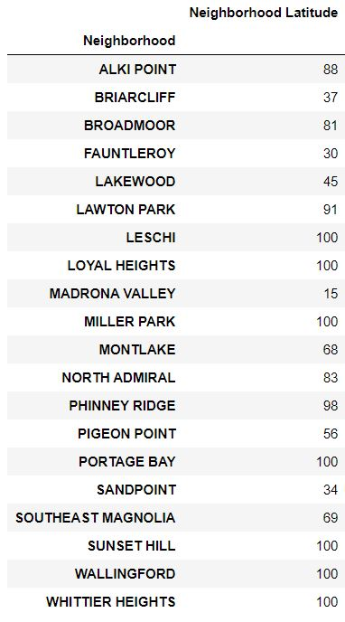
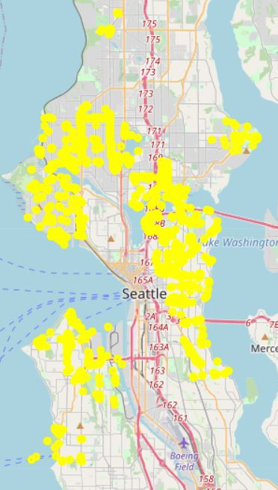
Explore venue categories in Cluster 3
Count of venues
Not all neighborhoods returned 100 venues
Table that grouped by neighborhood to get count of venues
229 unique venue categories
Map of the venue locations

Slide 20
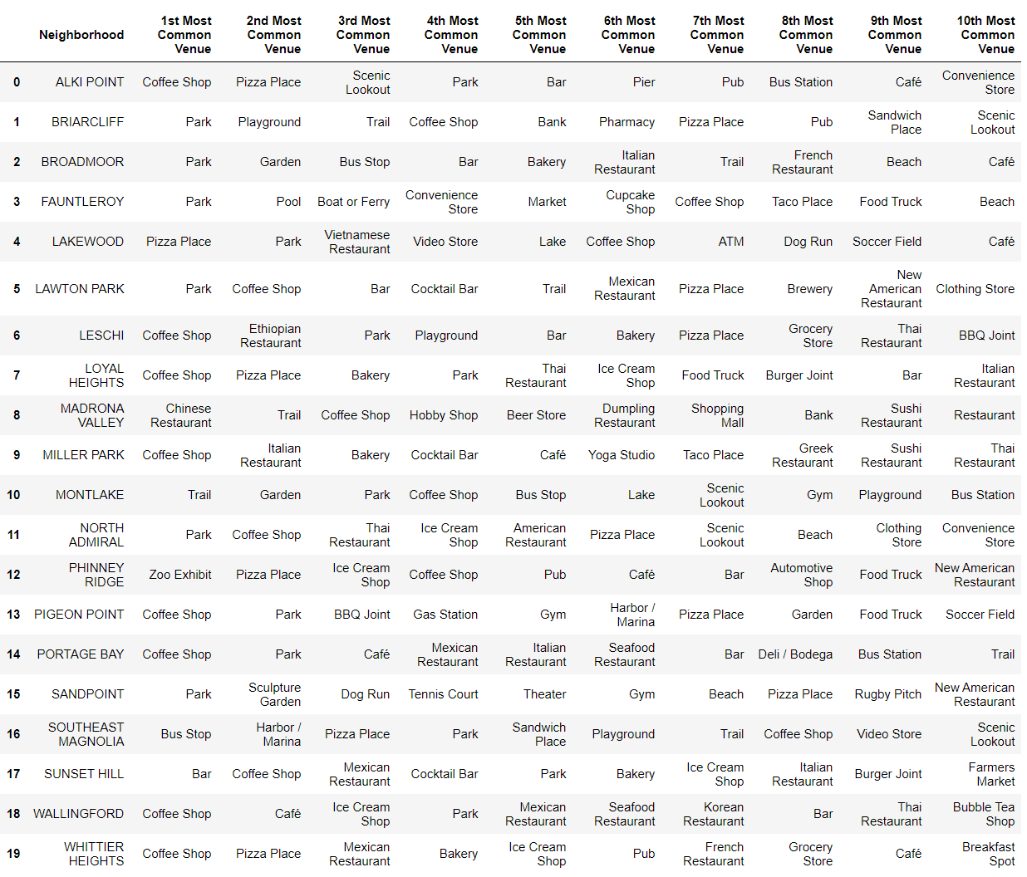
Top 10 most common venue categories for each Cluster 3 neighborhood

Slide 21
Picking the best neighborhood
Madrona Valley picked as the best neighborhood for me because of its closeness to international cuisine, ie. Chinese and dumpling restaurants
Wallingford comes second (note: bubble tea shop as 10th most common venue)
Observations: coffee shops & parks as most common venue throughout = suburbs?

Slide 22
Summary/Conclusion
Safest cluster to live in: Cluster 3
Best neighborhood in Cluster 3 for me: Madrona Valley
Caveat: venues given by Foursquare are highly dependent on when the API was called so will yield different results each time
Seattle districts also are not well-defined. Could be missing some districts in my analysis.
Thanks for viewing!

